Slide 1
The ITU Radio Regulations and its key role in global spectrum harmonization
Mario Maniewicz
Deputy Director, Radiocommunication Bureau
International Telecommunication Union
VII International Spectrum Congress
5 - 6 September 2017, Bogota

Slide 2
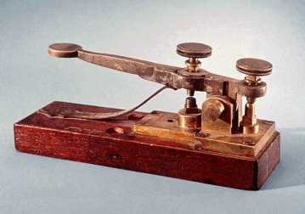
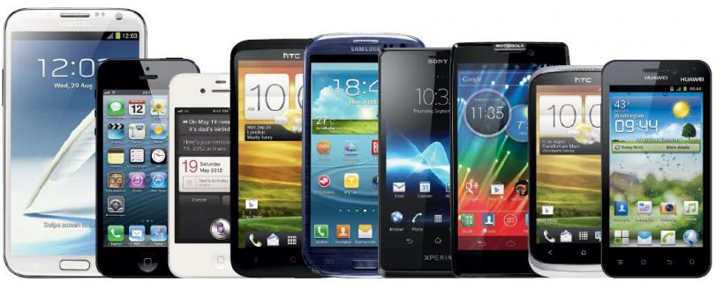
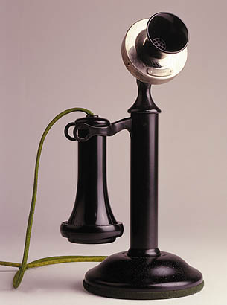
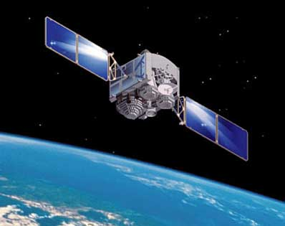
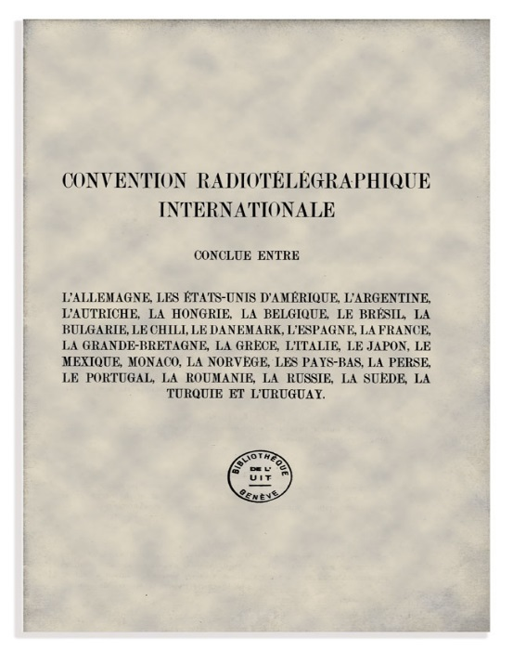
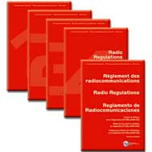
Radiocommunications and ITU
1906 2016
Regulations anticipate and accommodate technological advancements
from the first International Radiotelegraph Convention, 1906 to the Radio Regulations, 2016

Slide 3
Radiocommunications in the ICT Ecosystem
Broadcasting and broadcasting satellite: TV and sound program delivery to population
Communication satellites: Broadband Mobile networks infrastructure, mobile and emergency communications in remote areas, Broadcasting infrastructure.
Fixed Networks: mobile networks infrastructure, fixed wireless access, backbone lines
Mobile Broadband networks: ubiquitous connectivity
Radiolocation: transport safety, anti-collision devices for intelligent transport systems (ITS), air/maritime traffic control
Radionavigation systems (space and terrestrial) : Location and navigation, a key component of the connected society
Scientific satellites: Earth Observation, Meteorology (sources of high value information on space, natural resources, climate change, weather and disaster prediction)

Slide 4
Long-Term Spectrum Planning
Radiocommunication networks, whether for mobile, satellites, broadcasting or other services, require very large investments for long periods.
Spectrum, the foundation on which they rely, should be stable and not be challenged over such long periods.
Long term spectrum planning, in a stable, sustainable and protective way, is essential to the success of radiocommunications.

Slide 5
Role of ITU in radiocommunications
Developing and updating international regulations on the use of orbit /spectrum at world and regional radio conferences
Applying these regulations
Developing and adopting standards and best practices on the use of orbit/spectrum
Disseminating information on these regulations, standards and best practices

Slide 6
Purpose of ITU WRCs
Create regulatory certainty for a multi-trillion dollars industry which provide services to billions of users worldwide and plays an increasingly important role in the development of our societies
For fixed, mobile, satellites and broadcasting industries, global spectrum harmonization is essential to create economies of scale, roaming and interoperability
Creating certainty requires consensus in order to achieve stable results. This demands time, efforts and patience.

Slide 7
Involvement of administrations, industry and other stakeholders in WRCs

Slide 8
ITU membership
All ITU members may participate in preparations for WRCs and attend WRCs in various capacities

Slide 9
WRC cycle
Develops agenda for the next WRC and preliminary agenda for subsequent WRC
4 years
WRC-n
1st Conference Preparatory Meeting (CPM)
organizes ITU-R preparatory studies to WRC
CPM-1
ITU-R studies
Develop technical, operational and procedural solutions for WRC
Consolidates results of studies and try to reconcile regulatory solutions
CPM-2
Allocation/identification of bands, regulations
WRC-n+1
- direct involvement of industry
- involvement through administrations or in the observer capacity

Slide 10
Key areas of participation (1)
WRC Agenda development - WRC establishes the agenda for the next WRC and a preliminary agenda for the subsequent WRC
The agenda is important, as it defines a legal scope for discussions, which remains stable
ITU-R Studies – the heart of WRC preparations, development of technical and regulatory basis for WRC decisions
Crucial role of industry in every step of studies, e.g. for IMT:
traffic estimations in Working Party 5D (WP5D)
Determining spectrum requirements (derived from traffic estimations)
identification of suitable bands
studies of compatibility between new IMT and existing applications
identification of candidate bands, regulatory solutions
Contribution of industry and other stakeholders is very valuable, especially in complex sharing studies where sometimes regulators may lack resources

Slide 11
Key areas of participation (2)
CPM-2 – consolidates the results of the ITU-R studies, agrees on regulatory solutions in the CPM Report
A key step in preparations – shaping proposals on spectrum allocations
Direct involvement of industry through input contributions and in discussions
WRC – the world highest decision-making entity on radio issues
A treaty making Conference, so the final say remains with the Member States, who are responsible for:
Managing national frequency allocation tables, issuing spectrum licenses, enforcing regulations at national level, updating national regulations to take account of modified ITU Radio Regulations
Industry participate in WRCs either as Member States’ delegates or as observers
Observers may submit information documents, provide advice (not proposals)
Not authorized to participate in the debates

Slide 12
Key areas of participation Regional preparations
The role of the 6 Regional Telecommunication Organizations is constantly growing, both before and during WRCs
They consolidate views at regional level, assist in interregional discussions, which facilitate reaching a common understanding and save time during WRCs (few views instead of 193 views of ITU Members)
WRC-15 two thirds (66%) of 678 docs were common proposals
ITU Radiocommunication Bureau facilitates coordination between regions by organizing ITU Inter-regional Workshops, participating in the meetings of regional groups
Role of the Regional Groups is described in WRC Resolution 72 dealing with world and regional preparations and originally developed at WRC-97

Slide 13
Key areas of participation National preparations
National preparations – starting point in WRCs process. Country activities result in adopting a national position for WRC, which is further developed in regional and international discussions
Regulators have to keep a balance between different spectrum users to respond to the needs of the population and national objectives ->
Trade-off between enabling emerging technologies and protecting incumbents, e.g. IMT vs. television in UHF band at WRC-15
Sometimes industry tries to create incentives for promoting new applications
demonstrating their benefits for the economy and population
providing financial assistance in spectrum re-farming, conversion, incentive/reverse auctions, etc.

Slide 14
Spectrum Harmonization
Benefits to be obtained from spectrum harmonization:
Economies of scale
Connectivity
Interoperability

Slide 15
Spectrum Harmonization
There are two main challenges that need to be resolved at WRCs in order to reconcile conflicting requirements by casting a proper balance between:
The need for worldwide harmonization (to benefit from economies of scale, connectivity and interoperability) and the need for flexibility in spectrum allocations (one size may not fit all countries)
The need to accommodate new systems, applications and technologies as they arise and the need to protect existing radiocommunication services and their technological evolutions.

Slide 16
WRC-19 Challenges
33.25 GHz of spectrum under study for IMT
2.1 GHz under study for HAPS at global level
9 GHz under study for FSS at global level
24.25 GHz without conflict between IMT and HAPS or non-GSO FSS

Slide 17
Thank you for your attention!
For more information: www.itu.int

